Slide 1
An Introduction to Probabilistic
Modelling in STAN
https://github.com/vinnydavies/stan_examples
Vinny Davies

Slide 2
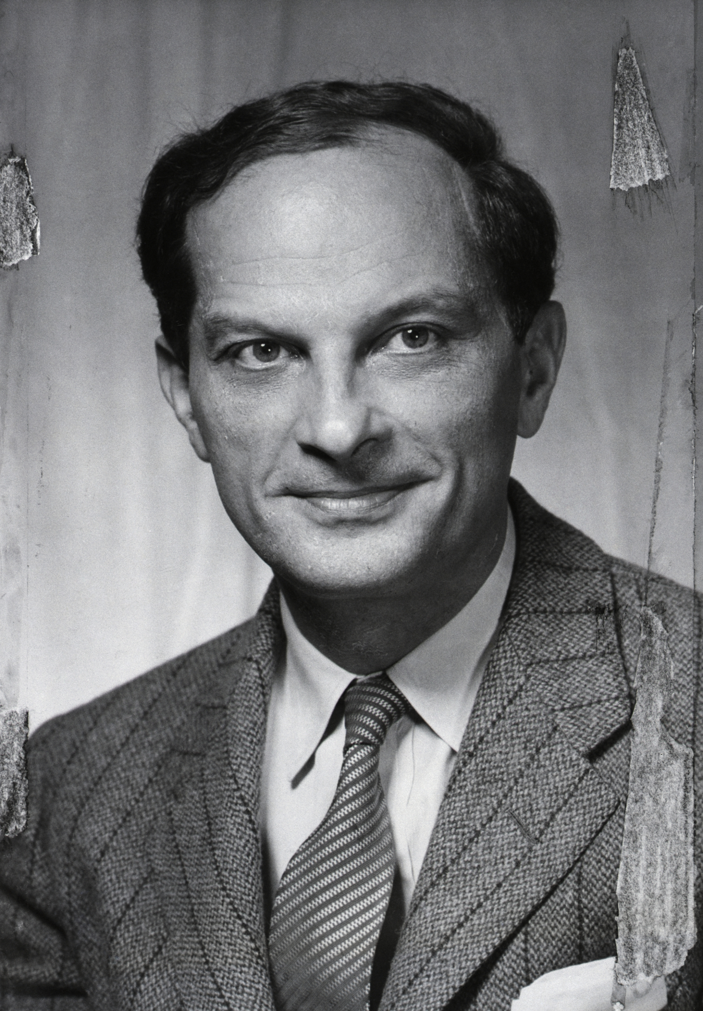
What is STAN? (https://mc-stan.org/)
STAN is a state-of-the-art platform for statistical modeling and high-performance statistical computation
STAN is named after Stanislaw Ulam, a mathematician who was one of the developers of the Monte Carlo method in the 1940s
Users can specify probabilistic models and Stan provides a framework for inference
Similar to JAGS, BUGS, PyMC etc

Slide 3
Probabilistic Modelling

Slide 4
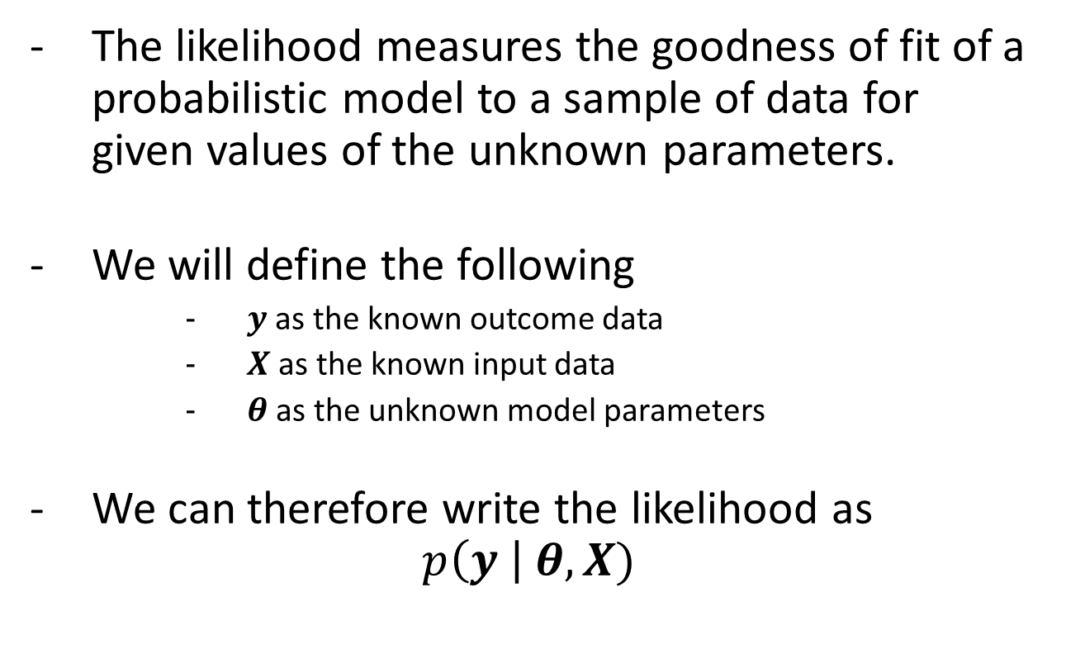
Likelihoods
The likelihood measures the goodness of fit of a probabilistic model to a sample of data for given values of the unknown parameters.
We will define the following
$y$ as the known outcome data
$X$as the known input data
$θ$ as the unknown model parameters
We can therefore write the likelihood as
$$p\left(y \right| θ, X)$$

Slide 5
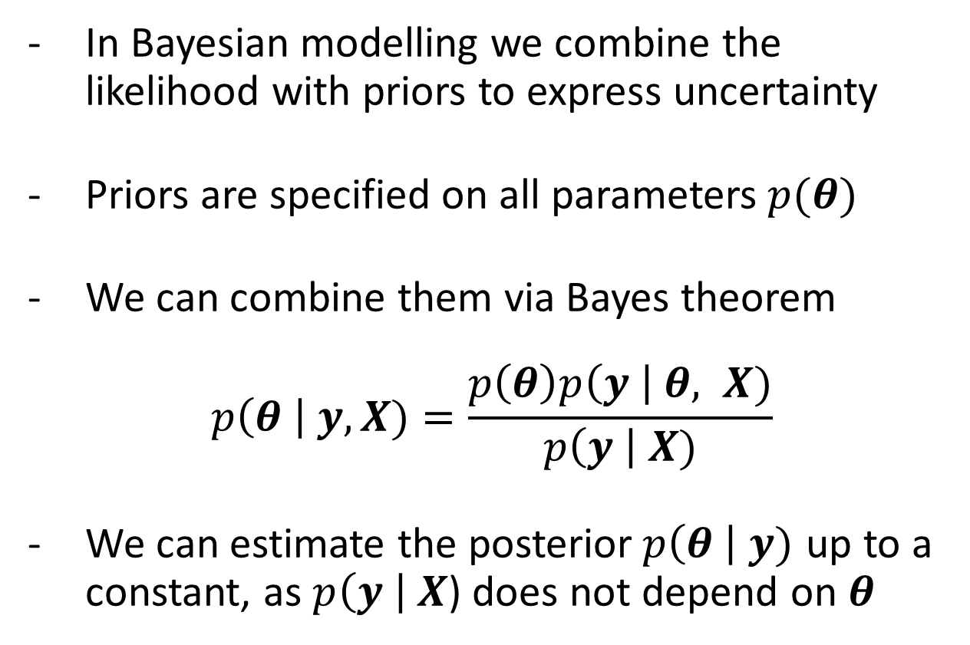
Bayes Theorem
In Bayesian modelling we combine the likelihood with priors to express uncertainty
Priors are specified on all parameters$p(θ)$
We can combine them via Bayes theorem
$$p\left(θ \right| y, X)=\frac{p\left(θ\right)p\left(y \right| θ, X)}{p\left(y \right| X)}$$
We can estimate the posterior$p\left(θ \right| y)$ up to a constant, as $p\left(y \right| X$) does not depend on $θ$

Slide 6
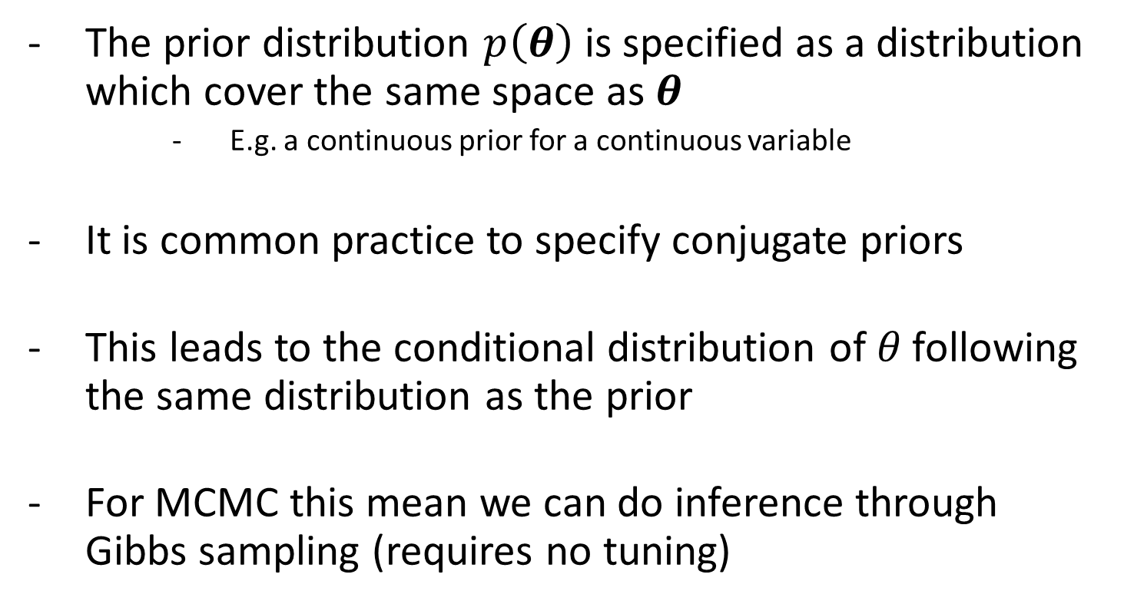
Priors
The prior distribution $p\left(θ\right)$ is specified as a distribution which cover the same space as $θ$
E.g. a continuous prior for a continuous variable
It is common practice to specify conjugate priors
This leads to the conditional distribution of 𝜃 following the same distribution as the prior
For MCMC this mean we can do inference through Gibbs sampling (requires no tuning)

Slide 7
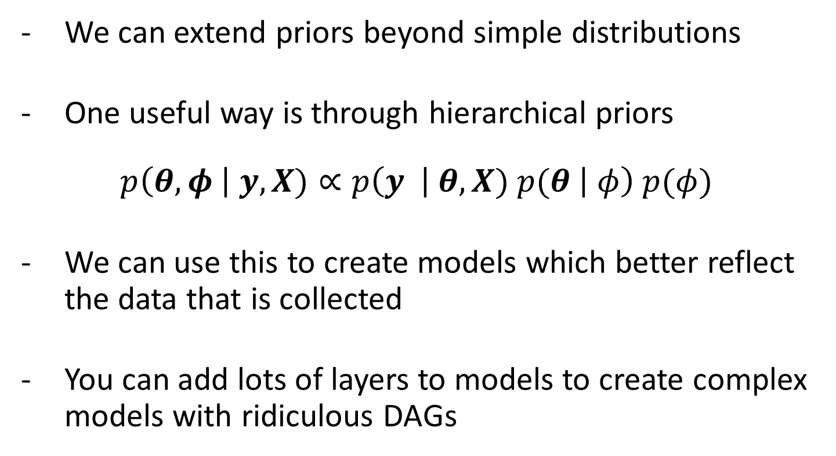
Hierarchical Models
We can extend priors beyond simple distributions
One useful way is through hierarchical priors
$$p\left(θ, φ \right| y, X)∝p\left(y \right| θ, X) p(θ \left| φ\right) p(φ)$$
We can use this to create models which better reflect the data that is collected
You can add lots of layers to models to create complex models with ridiculous DAGs

Slide 8
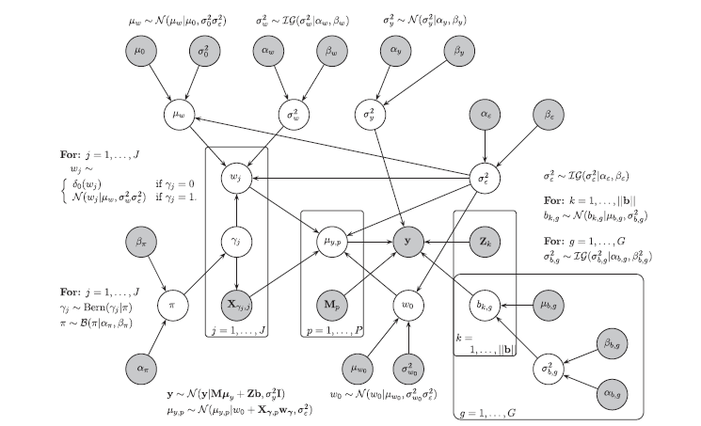
Example of Overly Complicated DAG

Slide 9
MCMC

Slide 10
Inference Methods
Maximum a-posteriori (MAP) estimation
Markov Chain Monte Carlo (MCMC)
Variation Inference
Expectation Propagation
MCMC has nice asymptotic properties, but can be slow. Variation methods can be faster, but with less guarantees

Slide 11
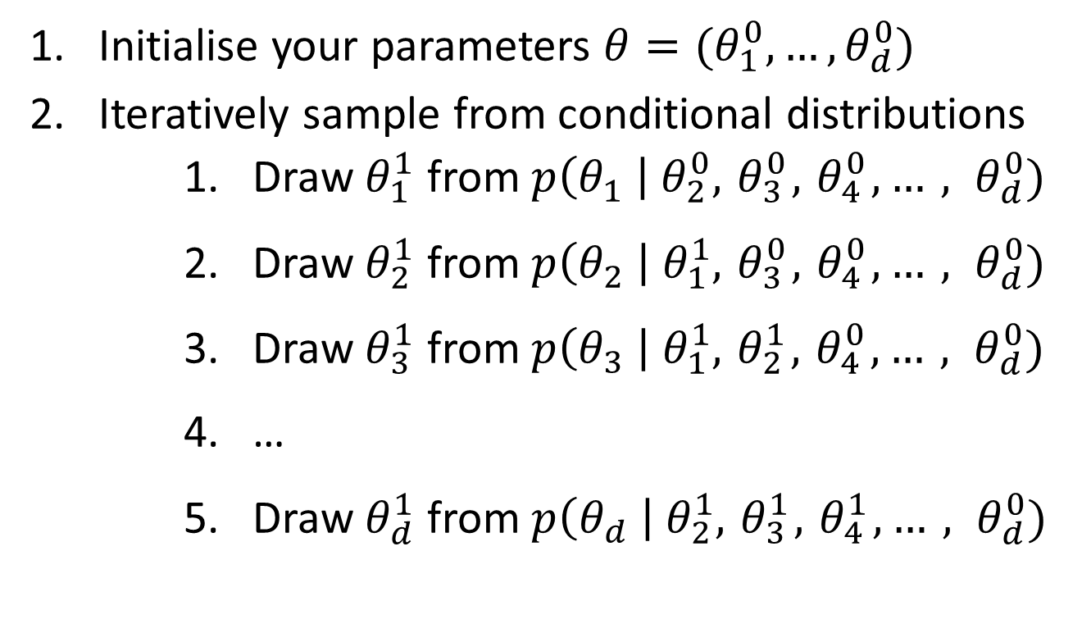
MCMC Sampling
Initialise your parameters $θ=(θ_{1}^{0}, …, θ_{d}^{0})$
Iteratively sample from conditional distributions
Draw $θ_{1}^{1}$ from $p\left(θ_{1} \right| θ_{2}^{0}, { θ}_{3}^{0},{ θ}_{4}^{0},…, θ_{d}^{0})$
Draw $θ_{2}^{1}$ from $p\left(θ_{2} \right| θ_{1}^{1}, { θ}_{3}^{0},{ θ}_{4}^{0},…, θ_{d}^{0})$
Draw $θ_{3}^{1}$ from $p\left(θ_{3} \right| θ_{1}^{1}, { θ}_{2}^{1},{ θ}_{4}^{0},…, θ_{d}^{0})$
…
Draw $θ_{d}^{1}$ from $p\left(θ_{d} \right| θ_{2}^{1}, { θ}_{3}^{1},{ θ}_{4}^{1},…, θ_{d}^{0})$

Slide 12
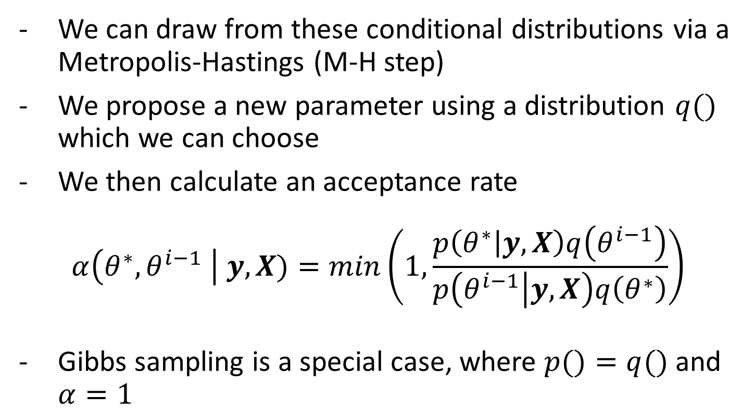
Metropolis Hastings
We can draw from these conditional distributions via a Metropolis-Hastings (M-H step)
We propose a new parameter using a distribution $q()$ which we can choose
We then calculate an acceptance rate
$$α\left(θ^{∗}, θ^{i−1} \right| y, X)=min\left(1,\frac{p\left(θ^{∗} | y, X\right)q\left(θ^{i−1}\right)}{p\left(θ^{i−1} | y, X\right)q\left(θ^{∗}\right)}\right)$$
Gibbs sampling is a special case, where $p()=q()$ and $α=1$

Slide 13
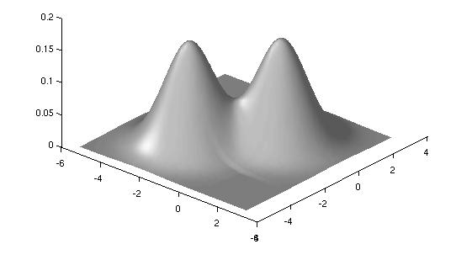
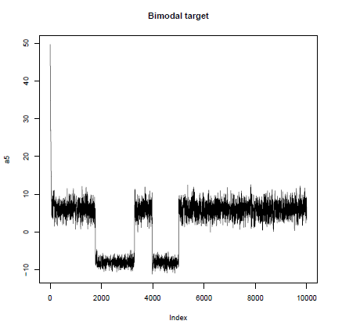
Convergence Diagnostics
Statisticians like to check their models have converged (Machine Learners don’t usually bother! 😭)
You should run multiple MCMC chains to ensure they are reach the same distribution
Some models can be multimodal

Slide 14
Convergence Diagnostics
Statisticians like to check their models have converged (Machine Learners don’t usually bother! 😭)
You should run multiple MCMC chains to ensure they are reach the same distribution
Some models can be multimodal
There are diagnostics to find when chains have not converged. E.g. Gelman Rubin
GR diagnostic compares the between and within chain variance

Slide 15
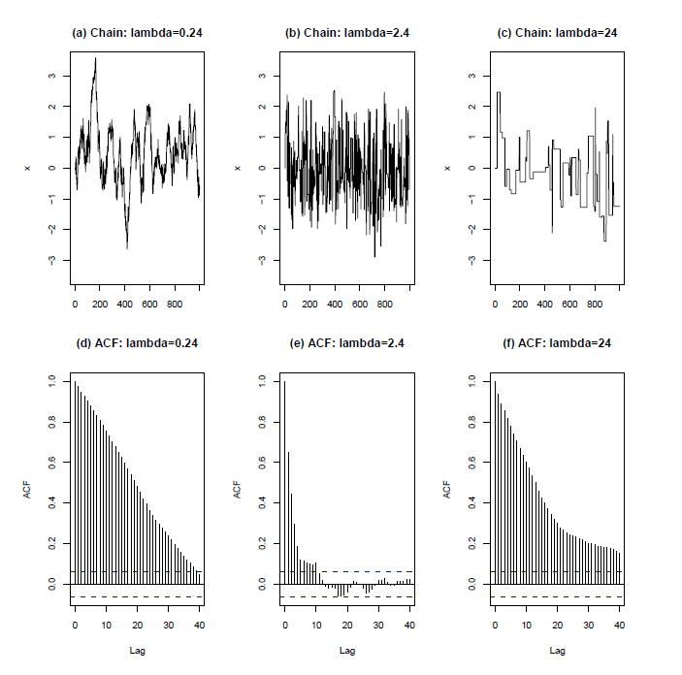
Mixing
Different sampling methods can have different efficiencies
Tuning parameters in M-H sampling can have a big effect
Efficiency can also effect convergence

Slide 16
Effective Sample Size
Monte Carlo methods depend on the previous parameter value
MCMC chain samples are therefore not independent
More efficient sampling means running less iterations to get the required effective sample size

Slide 17
Advanced MCMC

Slide 18

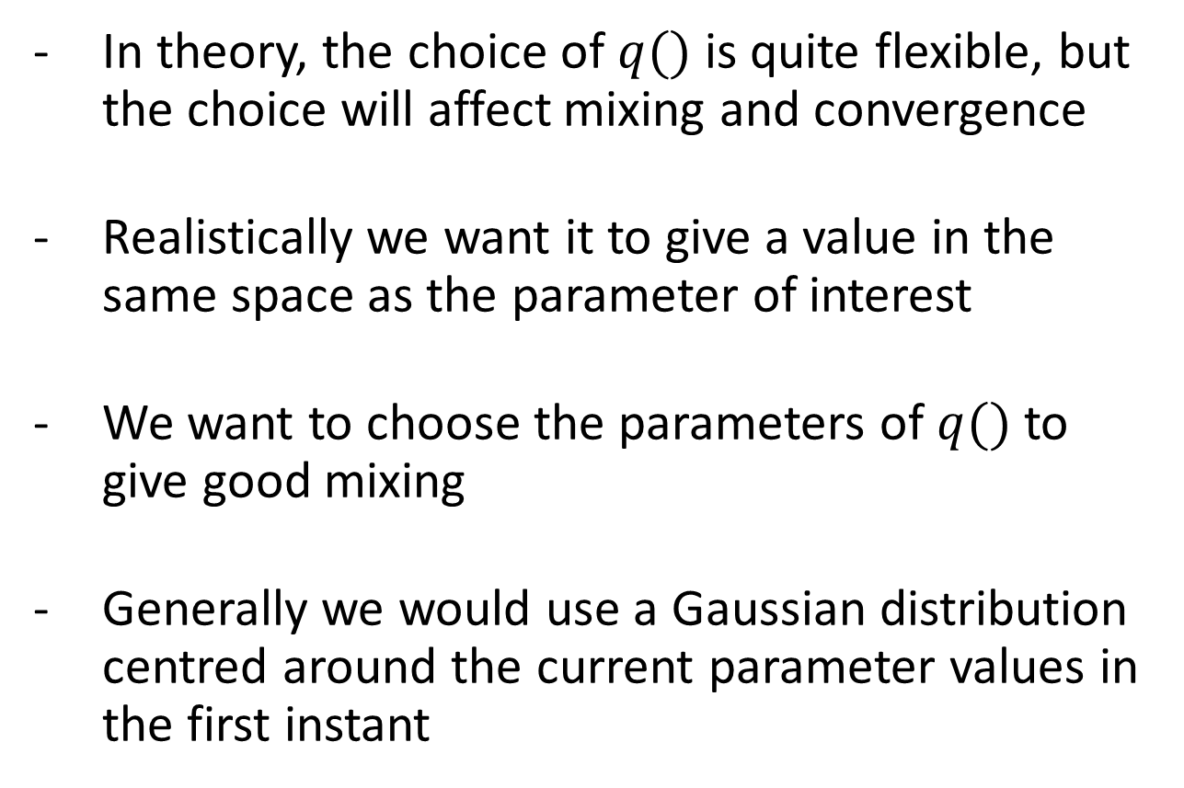
Choosing $q()$
In theory, the choice of $q()$ is quite flexible, but the choice will affect mixing and convergence
Realistically we want it to give a value in the same space as the parameter of interest
We want to choose the parameters of $q()$ to give good mixing
Generally we would use a Gaussian distribution centred around the current parameter values in the first instant

Slide 19
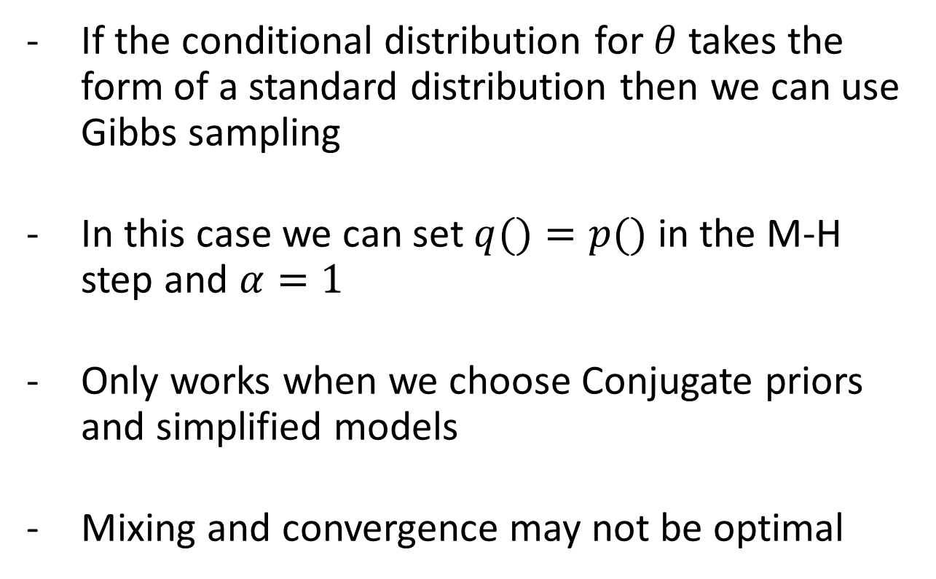
Gibbs Sampling
If the conditional distribution for $θ$ takes the form of a standard distribution then we can use Gibbs sampling
In this case we can set $q()=p()$ in the M-H step and $α=1$
Only works when we choose Conjugate priors and simplified models
Mixing and convergence may not be optimal

Slide 20
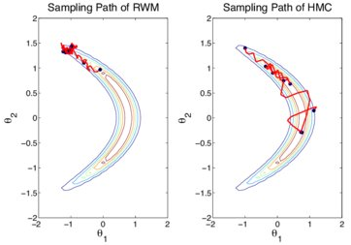
Gibbs Sampling
Can be effective in some scenario and not in others
Independently sampling two highly correlated parameters can be extremely slow

Slide 21
Metropolis-Hastings Sampling
We can potentially improve efficiency in these scenarios using HMC
Basic MCMC would require you to choose multiple tuning parameters to do this
This choice affects efficiency

Slide 22
Metropolis-Hastings Sampling
We can potentially improve efficiency in these scenarios using HMC
Basic MCMC would require you to choose multiple tuning parameters to do this
This choice affects efficiency
In scenarios like the banana distribution, the optimal choice of tuning parameters in one location would be awful in another location

Slide 23
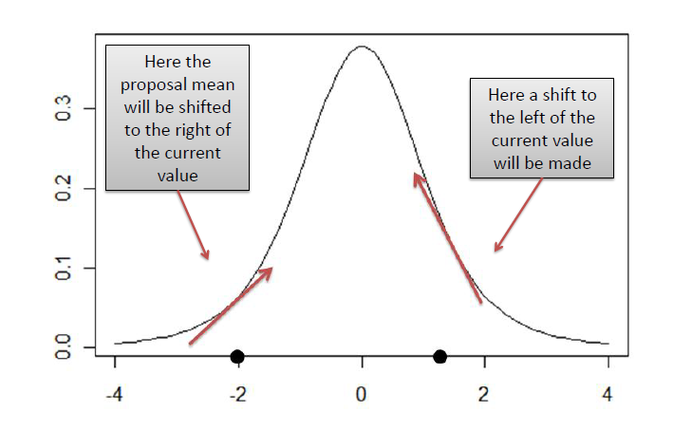
Adaptive MCMC
Standard MCMC does not take into account the shape of the posterior
Adaptive MCMC method adjust this distribution to take into account the shape of the posterior
Basic adaptive methods simply use the gradient to propose parameter values with a higher chance of being accepted

Slide 24
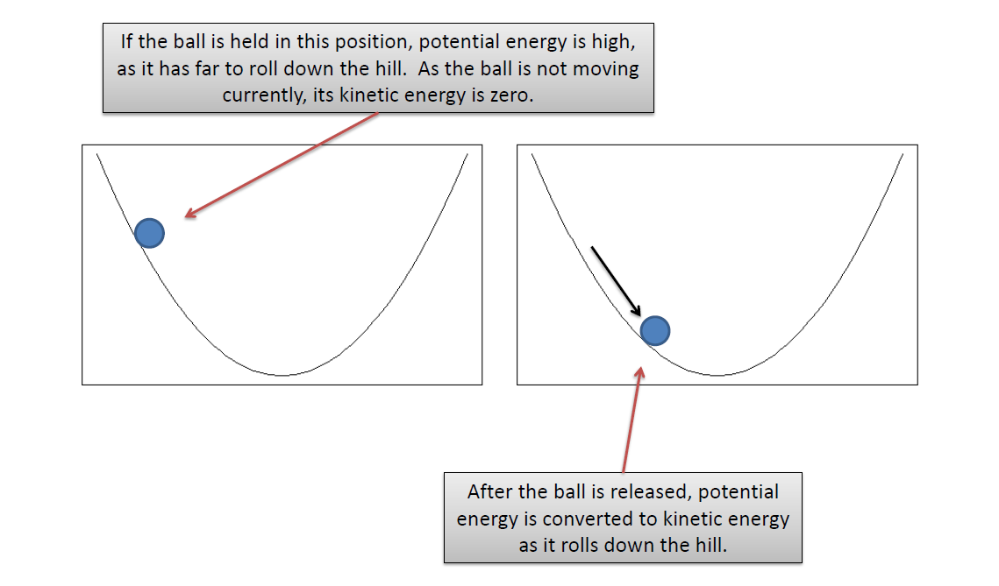
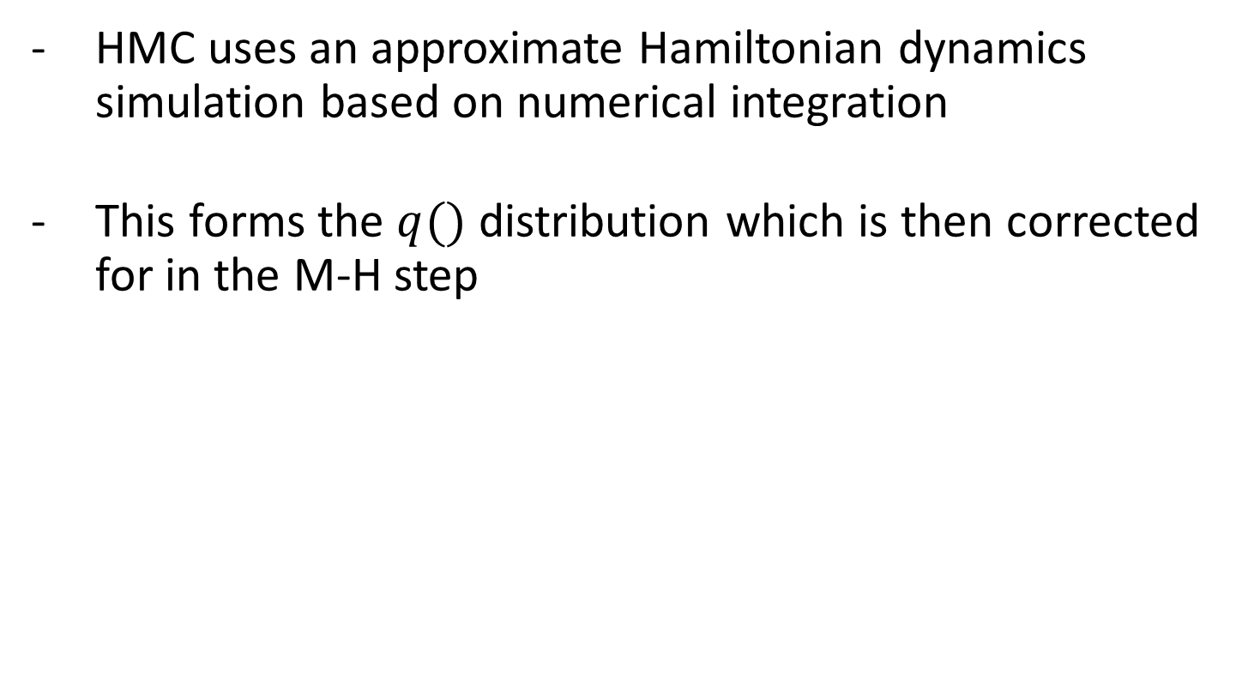
Hamiltonian Monte Carlo (HMC)
HMC uses an approximate Hamiltonian dynamics simulation based on numerical integration
This forms the $q()$ distribution which is then corrected for in the M-H step
HMC keep track of the energy through Hamiltonian dynamics

Slide 25
No-U-Turn-Sampler (NUTS)
HMC can be sensitive to 2 user set parameters
One of these is the number of step taken per iteration (basically how big a move can you make)
NUTS provides a way of stopping the method if it begins to retrace its step
E.g. if it has taken too many step / the ball has started to roll back down the hill
NUTS also has an algorithm for automating the choice of the other user defined parameter

Slide 26
STAN

Slide 27
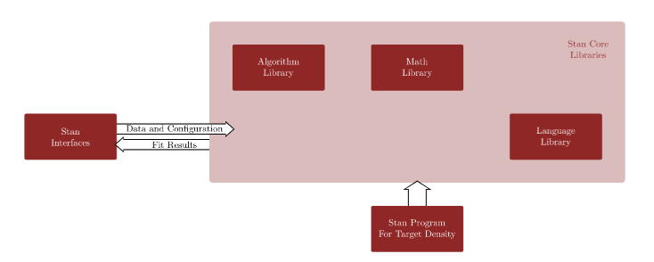
How STAN Works
Specify model and data
Core STAN libraries convert STAN program into executable program
Executable program can calculate the log posterior density and its gradients
Executable program then runs a high performance implementation of HMC

Slide 28
How STAN Works
The Stan Algorithm Library has 3 gradient based methods c++ algorithms
Dynamic HMC
BFGS optimiser
a highly experimental version of automatic differentiation variational inference (ADVI)
All my examples will be using HMC because:
I am a statistician…
The optimizer and ADVI are much more fragile, and failures are hard to diagnose.

Slide 29
Why STAN?
STAN
Easy to design complex models
Requires no maths to sample from model
Trivial to change models
STAN vs JAGS / BUGS
HMC / NUTS algorithm is highly efficient
JAGS / BUGS can get tuck with long tailed distributions etc
STAN is memory efficient
STAN vs PyMC
Differences less clear
STAN more prominent in stats community, PyMC more so in CS – hence why I am telling you about STAN not PyMC

Slide 30
Basic STAN Format
https://betanalpha.github.io/assets/case_studies/stan_intro.html
STAN is set up in a block structure
The following blocks are allowed
Functions
Data
Transformed Data
Parameters
Transformed Parameters
Model
Generated Quantities (values of interest calculated after inference)

Slide 31
STAN – Linear Model

Slide 32
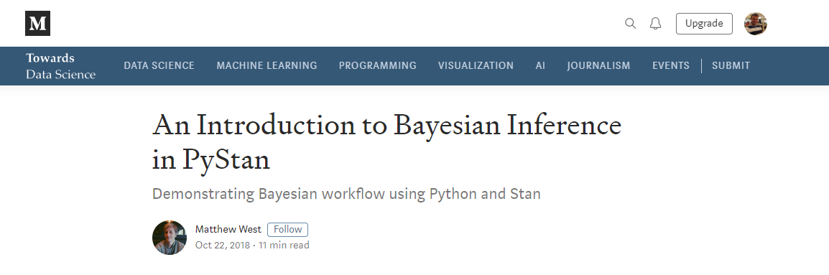
Linear Model - Example
https://towardsdatascience.com/an-introduction-to-bayesian-inference-in-pystan-c27078e58d53
R example (which we are using here, SORRY!)
https://michaeldewittjr.com/resources/stan_linear_regression.html

Slide 33
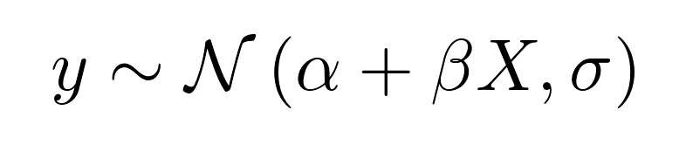
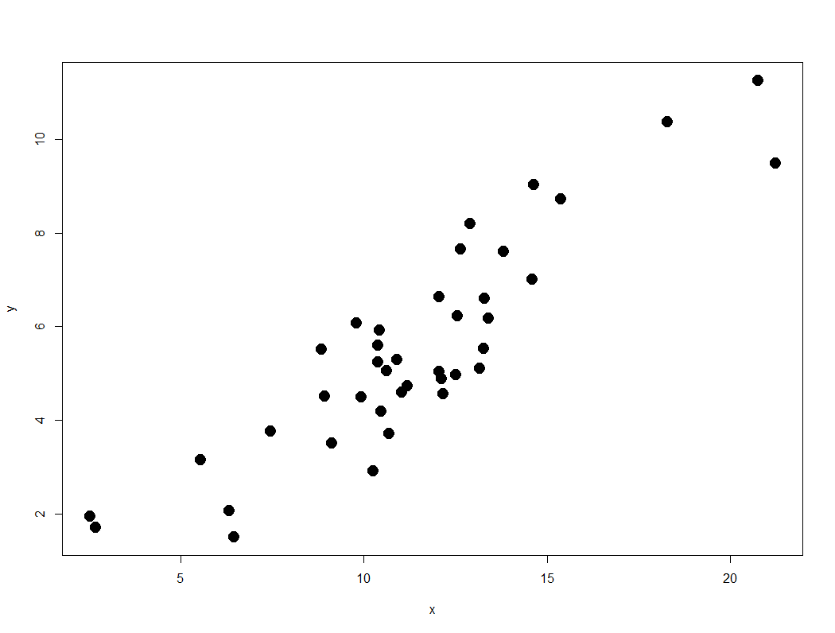
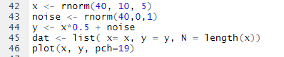
Linear Model – Example
Model
Data

Slide 34
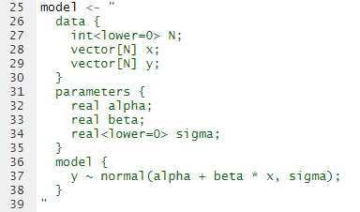
Linear Model – Model Specification

Slide 35
Linear Model – Model Specification
Data
Need to specify data types
Data is provided at a later point
Can be Real and Int
Stan allows vectors, matrices, arrays etc
Constraints can be added

Slide 36
Linear Model – Model Specification
Parameters
Set up parameters
Only Real parameters can be provided within this block

Slide 37
Linear Model – Model Specification
Model
Set up model
No prior here (assumes uniform)
Model can also be specified in other ways
This includes using user specified functions

Slide 38
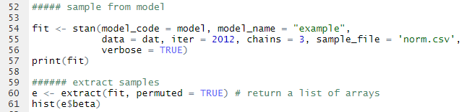
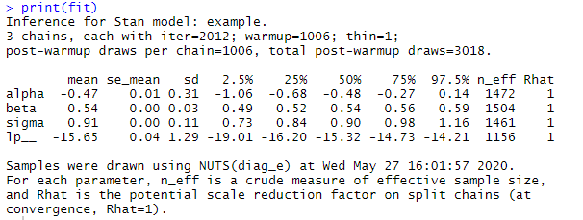
Linear Model – Fit Model

Slide 39
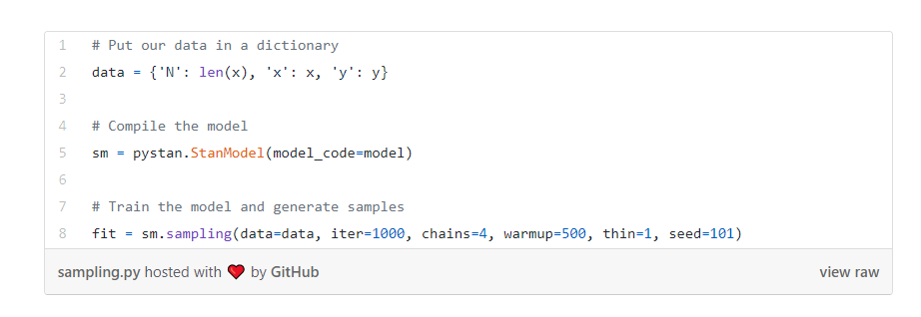
Linear Model – Python Version
Python uses basically the same code to set up the model
We can then fit the model as follows

Slide 40
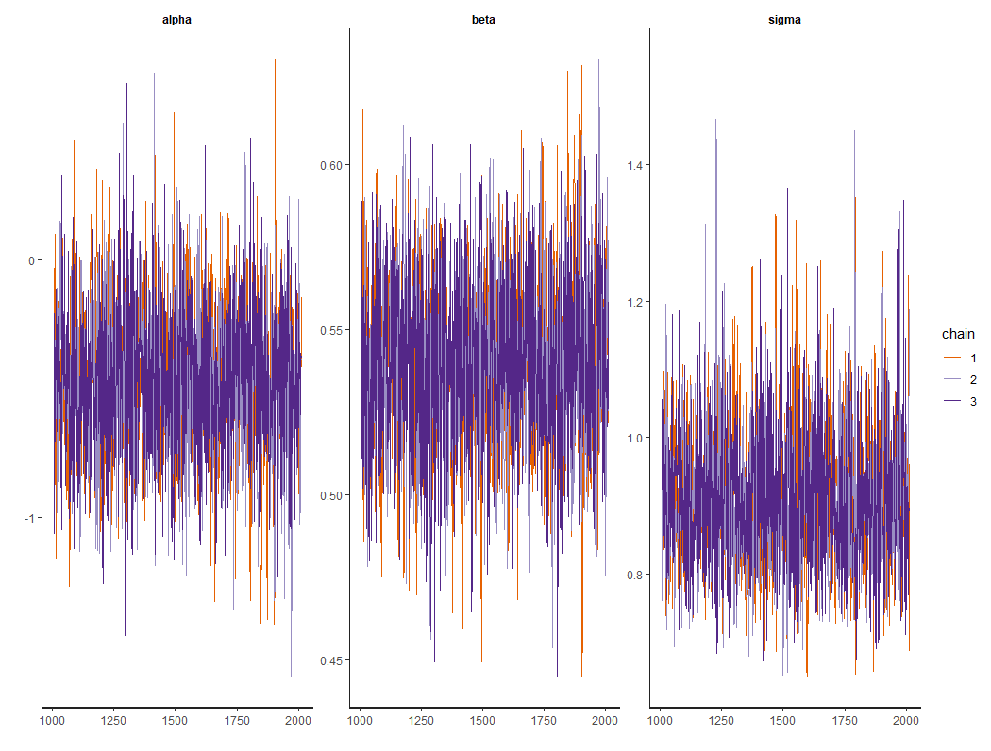
Linear Model – Results

Slide 41
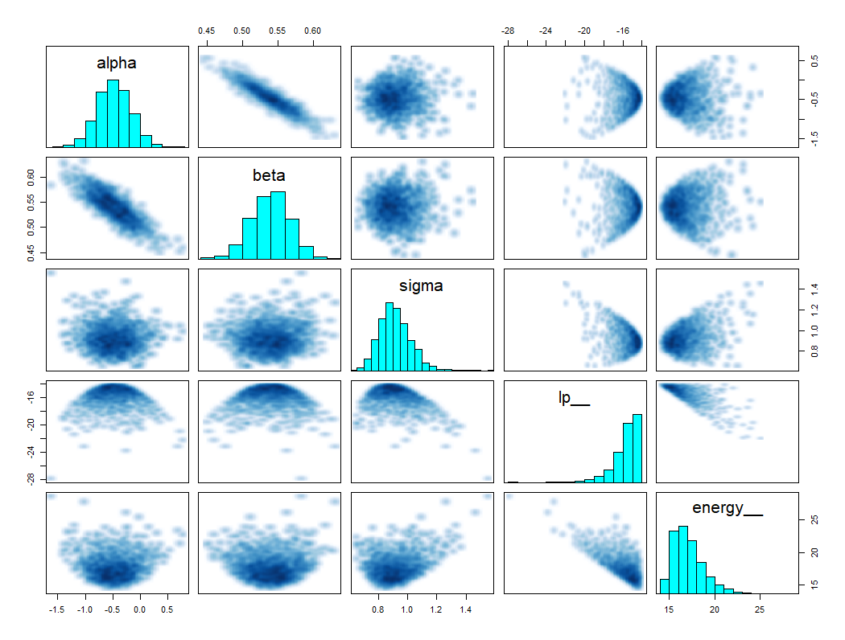
Linear Model – Results

Slide 42
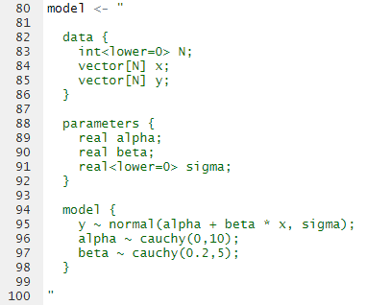
Linear Model – Adjusting the Priors
We can add priors where appropriate
These are supposedly recommended by Gelman (I haven’t checked this)

Slide 43
STAN – 8 Schools Example

Slide 44
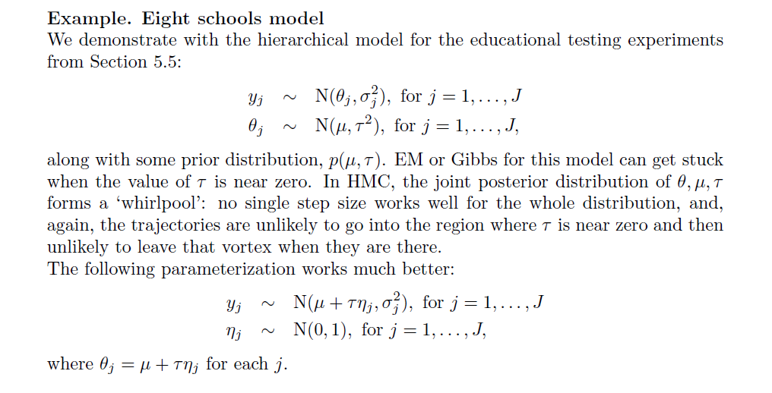
8 Schools - Model
https://cran.r-project.org/web/packages/rstan/vignettes/rstan.html#preparing-the-data

Slide 45
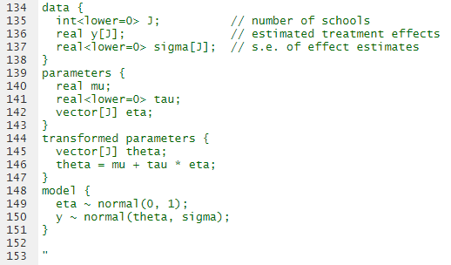
8 Schools – Model Specifications
- Standard error is fixed in the data in this case

Slide 46
8 Schools – Model Specifications
Define the parameters we are going to infer
Define transformed parameters to make it easier to specify the model

Slide 47
8 Schools – Model Specifications
Specify model using parameters and transformed parameters
Model can be specified in other ways – quicker if vectorised

Slide 48
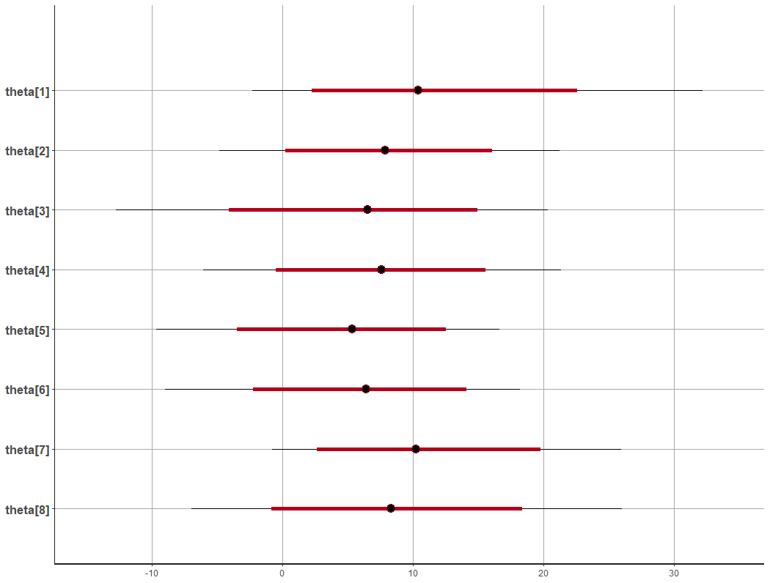
8 Schools - Results

Slide 49
STAN – Gaussian Processes

Slide 50
Gaussian Processes – Examples / Tutorials
There is a chapter in the STAN manual
https://mc-stan.org/docs/2_23/stan-users-guide/gaussian-processes-chapter.html
There is also a good worked example by Michael Betancourt
https://betanalpha.github.io/assets/case_studies/gp_part1/part1.html and part 2 + 3

Slide 51
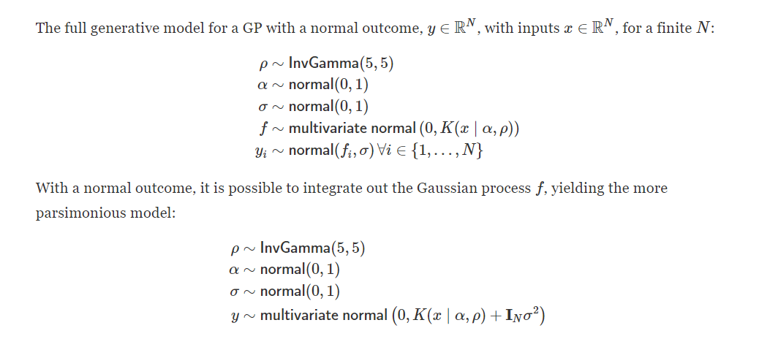
Gaussian Processes - Model

Slide 52
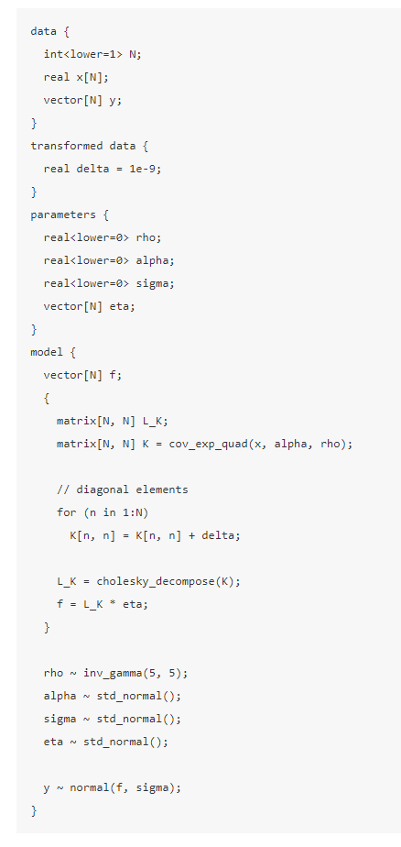
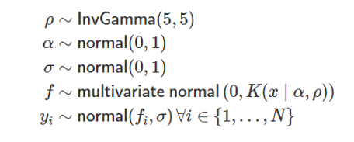
Gaussian Processes – Model (Latent Variable Version)

Slide 53
Gaussian Processes – Model (Latent Variable Version)
We can fit the full latent variable model version
Contains N + 3 parameter, so can be slow for large models
This can be useful when we have non normal outcomes

Slide 54
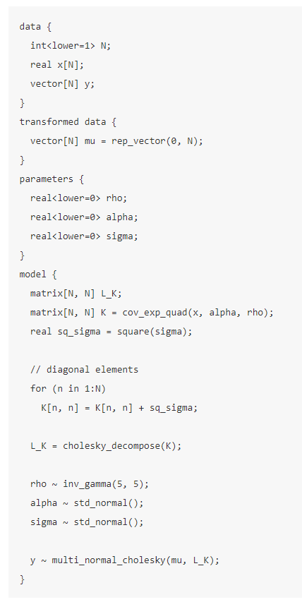
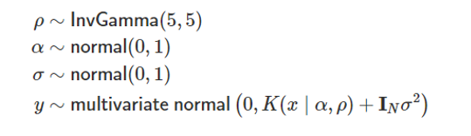
Gaussian Processes – Model (Marginal Version)

Slide 55
Gaussian Processes – Model (Marginal Version)
We can also fit the marginal version of the model
3 parameters, so can be much quicker to fit
We can explicitly code the kernels, in this can we have used the built in function

Slide 56
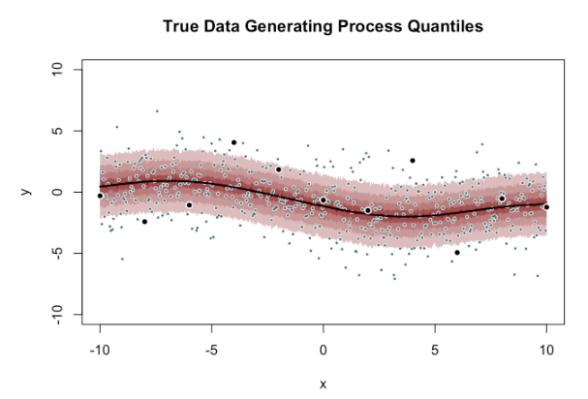
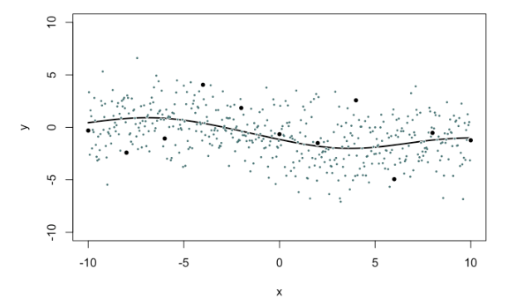
Gaussian Processes – Example Data
Simulated data
Line – True Model
Large, black dots – Observed data
Small, blue? dots – out of sample data
Red shading – true quantiles

Slide 57
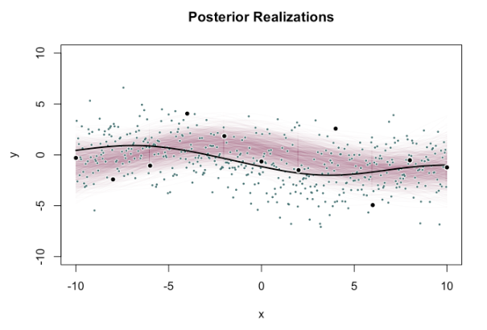
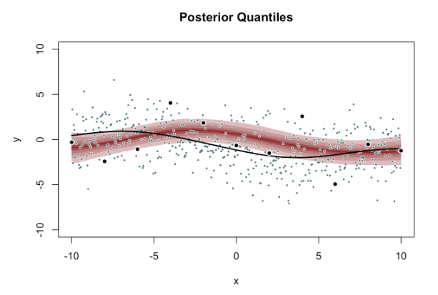
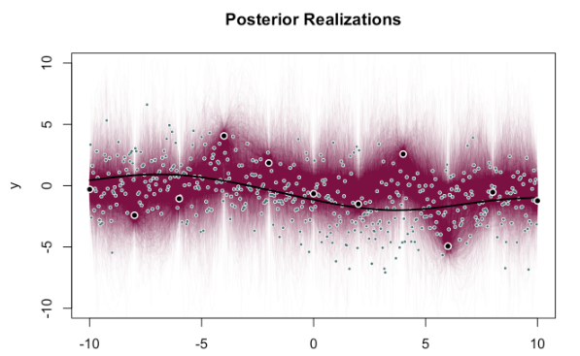
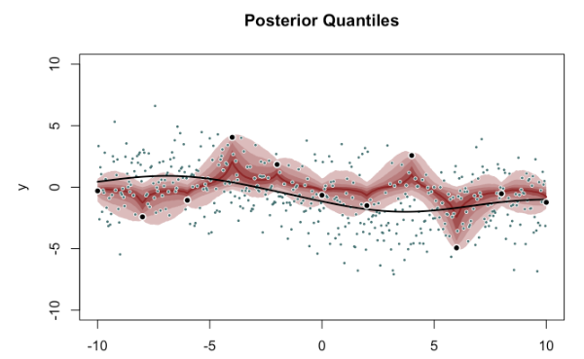
Gaussian Processes -
Inference via optimisation with fixed true hyperparameters
Fully Bayesian inference with weakly informative priors

Slide 58
Useful Resources

Slide 59

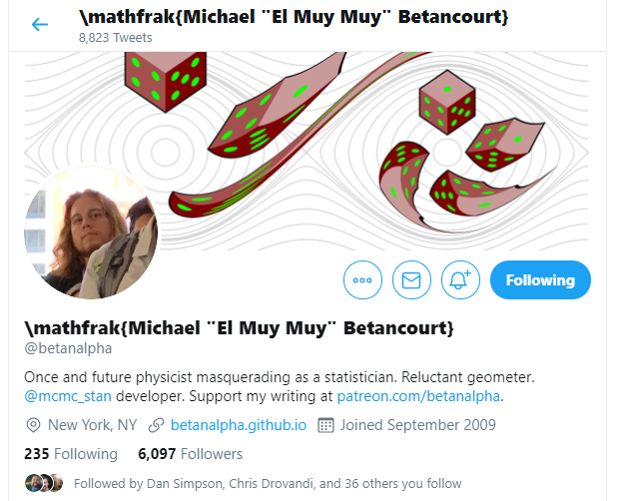

Twitter

Slide 60

BDA Examples (R and Python)
https://github.com/avehtari/BDA_course_Aalto

Slide 61
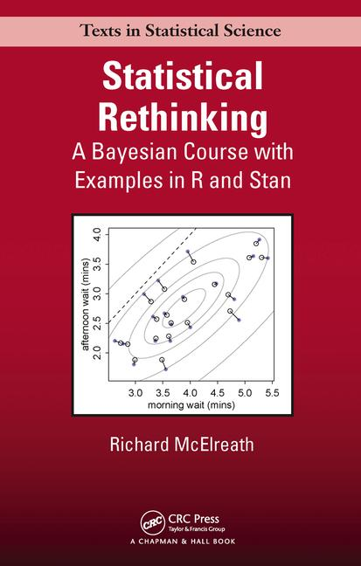
Case Studies
Worked Case Studies
https://betanalpha.github.io/writing/
Statistical Rethinking - Book with R code
I have one you can borrow post-apocalypse (Thanks @Simon)
STAN Manual
https://mc-stan.org/users/documentation/

Slide 62
MCMC / Hamiltonian Monte Carlo
Online talks
https://betanalpha.github.io/speaking/
Stan Examples and MCMC Theory
Online Bayesian Modelling Courses
E.g. https://www.coursera.org/learn/mcmc-bayesian-statistics
Online lectures
E.g. http://videolectures.net/mlss09uk_murray_mcmc/

